Slide 1

Concept Note for New Housing Ideas Limited (NHIL)
New
Housing
Ideas (NHI)
“Thinking Global, Acting Local”
www.nhi.com.ng
www.nhif.com.ng
A Proposed ColIaboration with the Federal Government of Nigeria
© February 2016

Slide 2
Outline
NHI
“Thinking Global, Acting Local”
Page
Introduction 3
Housing in Nigeria 7
New Housing Ideas Limited (NHIL) 18
Building Technology & Development Approach 24
Housing Finance 31
Marketing & Sales 35
Implementation Plan 39
Request 43
Appendix 47
© February 2016

Slide 3
Introduction
NHI
“Thinking Global, Acting Local”
© February 2016

Slide 4
Introduction
We would like to thank you for the opportunity to present our thoughts on how we can support the Federal Government of Nigeria (FGN) in the Planning, Management and Delivery of Housing to meet the needs of the country for the purpose of providing Affordable Housing.
We the New Housing Ideas Limited are proposing the collaboration with Federal, State and Local Governments of Nigeria. This is also in conjunction with a consortium of Nigerian Banks, Foreign Direct Investors and Development Partners (Local and International).
Collectively, we are to cater for the Low-Low, Low-Medium and Low- High categories of income earners. We shall develop Affordable, Cost Effective and Sustainable Housing Nationwide.
We are currently in advanced negotiations for investment and construction funds at very low interest rates. Targeting single digits – Documents of indicative offers have been attached at the end of this presentation.
NHI
“Thinking Global, Acting Local”
© February 2016

Slide 5
Introduction Contd.
This Housing Initiative would guarantee access to long term Mortgage facilities coupled with very low interest rates. Our Team has the Leadership, Passion, Commitment with Professional Expertise, and Financial reach to deliver on these goals.
The New Housing Ideas Limited (NHIL) will sponsor the NATIONAL HOUSING INITIATIVE FOUNDATION (NHIF) and will actively fund and Subsidize Low Cost Housing under this Foundation by ploughing back some of the profits made from High Income Housing projects as a form of “Cross-Subsidy” in the building of affordable houses for the Low-Low, Low-Medium and Low-High income groups Nationwide.
The NHIF would also supplement it’s income by accepting donations, grants and aids from both Local and International sources to achieve it’s housing objectives.
We the NHIL have set a goal of 200,000 mixed development to include Low, Medium and High Income brackets at the first stage Nationwide. These we have programmed to deliver within the first half of the tenure of this administration.
NHI
“Thinking Global, Acting Local”
© February 2016

Slide 6
Proposed NHIF Organisational Set Up
NHI
“Thinking Global, Acting Local”
Grand Patron
Sir Kessington Adebutu
Africa
Mr. Donald Duke
Asia
Engr. B.S Khurana
Australia
Mr. Colin Archer
Europe
Mr. Graham Barnes
Middle - East
Dr. ‘Layo Adeniyi
North America
Capt. Nikolas
Skarvelis
South America
Chairman Country (Nigeria)
Chief Kenny Martins
Chairman
South West
Prof. Kunle Ade Wahab
Chairman
South East
Sen. Annie Okonkwo
Chairman
South South
Olorogun O’tega Emerhor
Chairman
North West
Alh. Zango Daura
Chairman
North Central
Chief Mrs Paulen Tallen
Chairman
North East
Hajia Aisha Ismail
(Aunty Dada)
CEO
Engr. Ibrahim Mustafa
Trustee
South West
Mrs. Morola Babalola
Trustee
South East
Chief Johnny Ucheaga
Trustee
South South
Mrs. Bolatito Obaigbo
Trustee
North West
Alh. Salisu Mohammed Nuhu
Trustee
North Central
Arc. Usman Yakawu
Trustee
North East
Alh. Shettima Buka
Technical
Department
Administrative
Department
Finance
Department
Legal
Department
Land
Department
Marketing
Department
© February 2016

Slide 7
Need for Housing
About half of Nigeria’s population live in cities
  with 80% living in slum conditions
The low and middle income families represent 65% of Nigeria population
  i.e 85% of the total housing demand in Nigeria
Cities are changing and evolving faster as a result of urbanisation and growth
  Population increase
  Rural –urban migration
Inadequate infrastructure and planning
  Lack of proper development control have manifested in deforestaion, congestion, poor health and poverty
According to Lagos State Government,
  seventy percent of the people in Lagos live in slums
  4 million extra homes are needed in Lagos to close the gap
“….. every single individual on earth has the potential and the right to live a decent life”
- Prof Yunus Mohammed, Nobel Laureate
NHI
“Thinking Global, Acting Local”
© February 2016

Slide 8
Urbanisation and Housing in Future Cities...
OECD estimates that 70% of the world’s population will live in urban areas by the year 2050
One-sixth (1/6) of the over 6 billion World population will live in urban slums
Cities are expected
  to manage and control the change
  to allow their communities to have a standard of living which meets modern day expectations
The need to provide affordable and cost effective housing development and transport infrastructure is critical to the sustainable development of cities
NHI
“Thinking Global, Acting Local”
© February 2016

Slide 9
Housing in Nigeria
NHI
“Thinking Global, Acting Local”
© February 2016

Slide 10
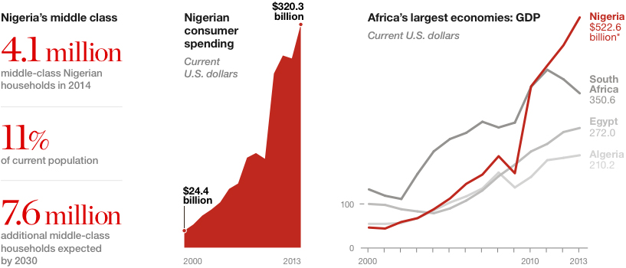
Nigeria as an Emerging Economy.........
NHI
“Thinking Global, Acting Local”
“…emerging market growth, at 43.4%, is forecast to be three times that of developed markets between 2013 and 2020. the consumer spending growth in emerging markets has outpaced that of developed countries every year since 2000 and is expected to continue to do so.”
“....... apart from infuencing global economic growth, emerging markets are also driving population growth”
The non-BRIC (Brazil, Russia, India, and China) markets are characterised as the frontrunners” when it comes the increase in spending.
“five non-BRIC markets (Indonesia, Pakistan, Nigeria, Bangladesh and Mexico) had populations of more than 100million, constituting a significant market share when considered as a whole.........Euromonitor report, 2014
The middle class are engine of consumer spending in the emerging markets – i.e people with a disposable income over US $10,000
The proportion of middle class houses in the world’s 20 largest non-BRIC emerging markets ranges from a high of 99.5 percent in the United Arab Emirates to a low of 4.8% in Kenya,...from around US $3,000-6,000 per household in Nigeria to US $74,000–150,000 in the United Arab Emirates.
Africa’s middle class families – those earning US $20,000 or more – outnumber India’s
“......128 million African households will earn US $5,000 a year or more by 2020 enabling them to spend half their income on non-food items.” – McKinsey & Company
nationalgeographic.com
“Nigeria possesses all the key factors for real estate investment — a growing middle-class population, growth in consumption, rapid urbanization and a youthful demography compared to more mature economies.....”
© February 2016

Slide 11
Overview of Real Estate Sector in Nigeria
NHI
“Thinking Global, Acting Local”
Key Trends
KEY STATISTICS
 | 2012 | 2013
Percentage Urban population (%) | 50.2 | 50.8
Residential and Non-residential Building Industry Values (N’bn) | 216.39 | 259.96
Real Estate Contribution to GDP (%) | 1.84 | 1.90
Growth Rate (%) | 9.74 | 11.33
Sixth largest sector in the economy;
Growing faster than the average GDP at a rate of 8.7% (GDP growth at 7.4%);
Estimated to grow from $11.4 billion to $16.5 billion over the next 2 years;
Growth attributed to growing middle class, including retail, industrial and commercial real estate development funded by local and international investors
High land prices driven by shortage in supply, recent naira devaluation and increase in inflation
Non availability of robust mortgage systems
25% home ownership rate compared to Kenya’s 73% and South Africa’s 56%
PwC, 2013
© February 2016

Slide 12
Overview of Real Estate Sector in Nigeria
NHI
“Thinking Global, Acting Local”
REAL ESTATE INDUSTRY CHAIN
Land
Acquisition
Project Development & Financing
Construction
Property Sales/Lease
Property Management
Land titles/agreements
Land allocation
Land purchase/lease
Project Planning
Preliminary and Detailed design
Environmental Assessment
Property development funding
Procurement
Construction activities on site
Property valuation, listing , advertising and marketing
Selling and letting of properties
Legal and agency activities
Manage properties, equipment and facilities.
Manage tenancy contracts
Key Activities
Sponsors (individuals / corporate)
Real Estate Developers
Mortgage Institutions
Financial Investors
Deposit Money Banks
NGO’s, Foundations and Trusts
Real estate agents
Original Land settlers (“Omo-onile”)
Regulatory authorities
Design and Construction firms
Real Estate Developers
Individuals
Corporates
Insurance Companies
Real estate agents
Landlords
Tenants
Real estate investors (Government, Individuals and Corporates)
NGO’s
Facilities Management firms
Cleaning & fumigation Services
Technical Maintenance and Repair services
Landscape Specialists
Interior Decorators
Key Players
Federal Ministry of Power, Works ,& Housing
Federal Housing Authority (FHA)
States Ministries of Lands/Housing/Urban Development
States Housing Corporations
FCTA
Nigerian Society of Engineers (NSE)
Nigerian Institute of Quantity Surveyors (NIQS)
Nigeria Institute of Architects (NIA)
Nigerian Institution of Estate Surveyors and Valuers (NIESV)
Nigerian Institute of Town Planning (NITP)
Nigeria Institute for Building
MDAs & Professional Association
© February 2016

Slide 13
Opportunities in the Housing Sector in Nigeria
NHI
“Thinking Global, Acting Local”
High Growth of Luxury Residential Development
Medium and Low Income Sector – Huge Gap Remains Untapped
Housing Finance
© February 2016

Slide 14
Key Issues and Challenges in perspective
NHI
“Thinking Global, Acting Local”
High unemployment rate - 7.5% (Q1 2015)
Minimum wage of N18,000 ($90.00)
Housing supply
  Estimated 17million housing deficit
  Current production of 100,000 units per year
  Estimated 800,000 units needed per year
Affordability -
  High cost of houses and rents in major cities such as Lagos, Abuja, ibadan, Enugu, Port Harcourt ; are beyond the reach of average Nigerian
    51percent of Nigerians live in rented accomodation
    Rented market dictated by landlords and estate agents with exorbitant charges
  2014 FGN Affordable Home Ownership Scheme (AHOS) minimum price was N4.5million ($22,500)
    Paid over 15 years at N25,000 monthly ($125.00)
    Above N18,000 minimum wage threshold
    Poor response to AHOS due to high prices
Previous government intervention mostly targeted middle income groups at the expense of the low income and informal . Our intervention would bring about change through the introduction of cross-subsidy by using part of the profit made from High and Medium High to subsidize the low income.
IMF estimates that
  Nigeria GDP per capita grew over 30 percent to $1,725 between 2003 to 2013
  Inequality has worsened to 68 percent
© February 2016

Slide 15
Reasons for high house prices in major cities ........
NHI
“Thinking Global, Acting Local”
High population increase as a result of rural-urban migration
Inadequate access to mortgage financing
  Stringent loan conditions from banks
  High cost of financing
  NHI would provide low interest rates (one digit) and long term mortgage repayment packages
High cost of building materials/construction – NHI would stimulate the existing local building materials manufacturers and encourage the establishment of more factories within two years of commencing the project. This we believe would drastically reduce cost e.g Demaak .
Accessibility, infrastructure and logistical challenges – Federal/State/Local Government would provide land with reasonable access to existing primary infrastructure while we take care of secondary.
Shortage of skilled labour/artisans – NHI would bring change by taking advantage of the skills acquisition centers Nationwide to assist and encourage in training the teaming youth on various skills like Masonry, Tilling, Carpentry, Painting, Plumbing e.t.c
Delays in processing land titles/approvals of C of O – NHI would negotiate faster processing times for Title documents as exemplified by the Lagos State Government.
© February 2016

Slide 16
Previous Governments Intervention in Policy and Regulatory Reform in the Housing Sector
NHI
“Thinking Global, Acting Local”
Land Use Act of 1978 vested all lands with the government
Affordable housing policy was introduced in 1979
  Civilian government
National Housing Fund Act (1992) and the Federal Mortgage Bank act (1993)
  Aimed to ensure constant supply of loans to Nigerians for the purpose of building, purchasing and improvement of residential properties
  FMBN administers and collects Federal housing fund
  FMBN serves as secondary mortgage institution providing credit facilities to primary mortgage instituions, real state development companies, housing corporation and operatives
1999 Nigerian Constitution – all citizen have the right to own and acquire immovable property
2002 Housing policy reforms
FGN 2006 National Housing Policy
  Targets safe, decent and affordable 1 million housing units per year
  Land swap initiatives
  Mass housing schemes
  Accessible mortgage scheme for low and middle income earners
© February 2016

Slide 17
Previous Governments Intervention in Policy and Regulatory Reforms in the Housing Sector
NHI
“Thinking Global, Acting Local”
Nigeria Vision20:2020 advocates for adequate housing for all Nigerian citizens;
Lagos State Government Lagos Tenancy Bill passed into law in 2011;
FGN 2012 National Housing Policy entrenched private sector financing;
  Through mass housing, skill acquisition, disaster management, urban renewal, slum upgrading and job creation
  Targets one million units houses annually through National Mortgage Refinancing Company (NMRC)
Nigeria Mortgage Refinancing Scheme was introduced in 2013;
In 2014, the National Assembly set up a committee for the amendment of 1978 Land Use Act;
FGN proposed reduction of land transaction fees from 16% to 3%; and
In January 2015, Lagos State reduced Land Use charges from 13% to 3% of property value
© February 2016

Slide 18
Mortgage Financing in Nigeria
Housing sector contribution to GDP
  Nigeria - 0.5%
  UK - 80%
  US 77%
  South Africa 31%
Introduction of Primary Mortgage Institution through Federal Mortgage Bank
  $100million for National Operating Banks
  $50million for Regional Banks
FGN introduced Nigeria Mortgage Refinancing Corporation - NMRC
  to fund banks/lenders for the construction of 75,000 homes annually
Intervention by local banks – with different mortgage products
World Bank estimates that
  There were 44,000 mortgages with an average size of 5 million naira ($31,472) each from 2004 to 2010
NHI
“Thinking Global, Acting Local”
© February 2016

Slide 19
National Housing Initiative
Foundation
NHI
“Thinking Global, Acting Local”
© February 2016

Slide 20
Project Description
NHI
“Thinking Global, Acting Local”
First Phase - 200,000 units residential development;
  Pilot Scheme/Project commences in the four cities below
    Lagos – 10,000
    Abuja – 10,000
    Port Harcourt – 5,000
    Kano – 5,000
To be located in the six-geo political zones in the country;
    South -West
    South - South
    South - East
    North - West
    North - East
    North – Central
© February 2016

Slide 21
Project Description
NHI
“Thinking Global, Acting Local”
PPP - Public (Federal Civil Service and Ministries, Departments and Agencies MDA’S), Private (Blue-Chip Companies, NGO’s, Individuals) Partnership arrangement;
Federal, State and Local Governments
  To provide land with approved C of O’s as their contribution towards providing Affordable Housing for it’s citizens and in fulfillment of their Social responsibilities.
  The National Housing Initiative Foundation (NHIF) will contribute towards the subsidy of the low income earners in the states.
© February 2016

Slide 22
NHIF Objectives
NHI
“Thinking Global, Acting Local”
To provide Affordable Housing all over the Country with the support of
  Federal/State/Local Governments;
  Local/International financiers such as Banks, Mortgage Institutions, Funds Managers and Private equity investors to provide cheap/single digit low interest funds and long term mortgage repayment packages for sustainable NHIF projects.
  How - This would be done by making use of the technology that would make the houses cheaper, adaptable and affordable.
  Benefit - NHIF would be providing affordable and sustainable communities in such states.
© February 2016

Slide 23
Potential Stakeholders/Sponsors/Investors
NHI
“Thinking Global, Acting Local”
.......for collaboration as soon as the proposal is approved
Sponsors/Investors/Other Stakeholders | Description | Examples
Technical/Construction | Planning, Design & Build/Construct/ Project management / Architecture/designing | Construction companies, PPP and Turnkey
Financial Institutions | Local/International Debt/Equity financing (project & corporate) - and mortgages | TBD
Federal/State/Local Government and FCT | Policy and regulatory control and implementation – including land /titles documentation, infrastructure (primary and secondary) | Federal Ministry of Power, Housing & Urban Development Federal Housing Authority (FHA) Office of the Surveyor-General Federal Ministry of Environment FCT
Developmental Aid/Finance Institutions | Support Government efforts in developing Real Estate sector capability and supporting / driving investments focused towards housing availability | DFID, World Bank/IFC, African Finance Corporation (AFC), African Development Bank (AfDB),
Professional Bodies | Experts advise/opinions on plannning, design and construction of housing | Nigeria Society of Engineers Nigeria Society of Architects Ngeria Institute for Building Nigeria Institute for Town Planners
© February 2016

Slide 24
Building Technology and Development Approach
NHI
“Thinking Global, Acting Local”
© February 2016

Slide 25
Technology
NHI
“Thinking Global, Acting Local”
© February 2016

Slide 26
Technology
NHI
“Thinking Global, Acting Local”
© February 2016

Slide 27
Technology
NHI
“Thinking Global, Acting Local”
© February 2016

Slide 28
Technology
NHI
“Thinking Global, Acting Local”
© February 2016

Slide 29
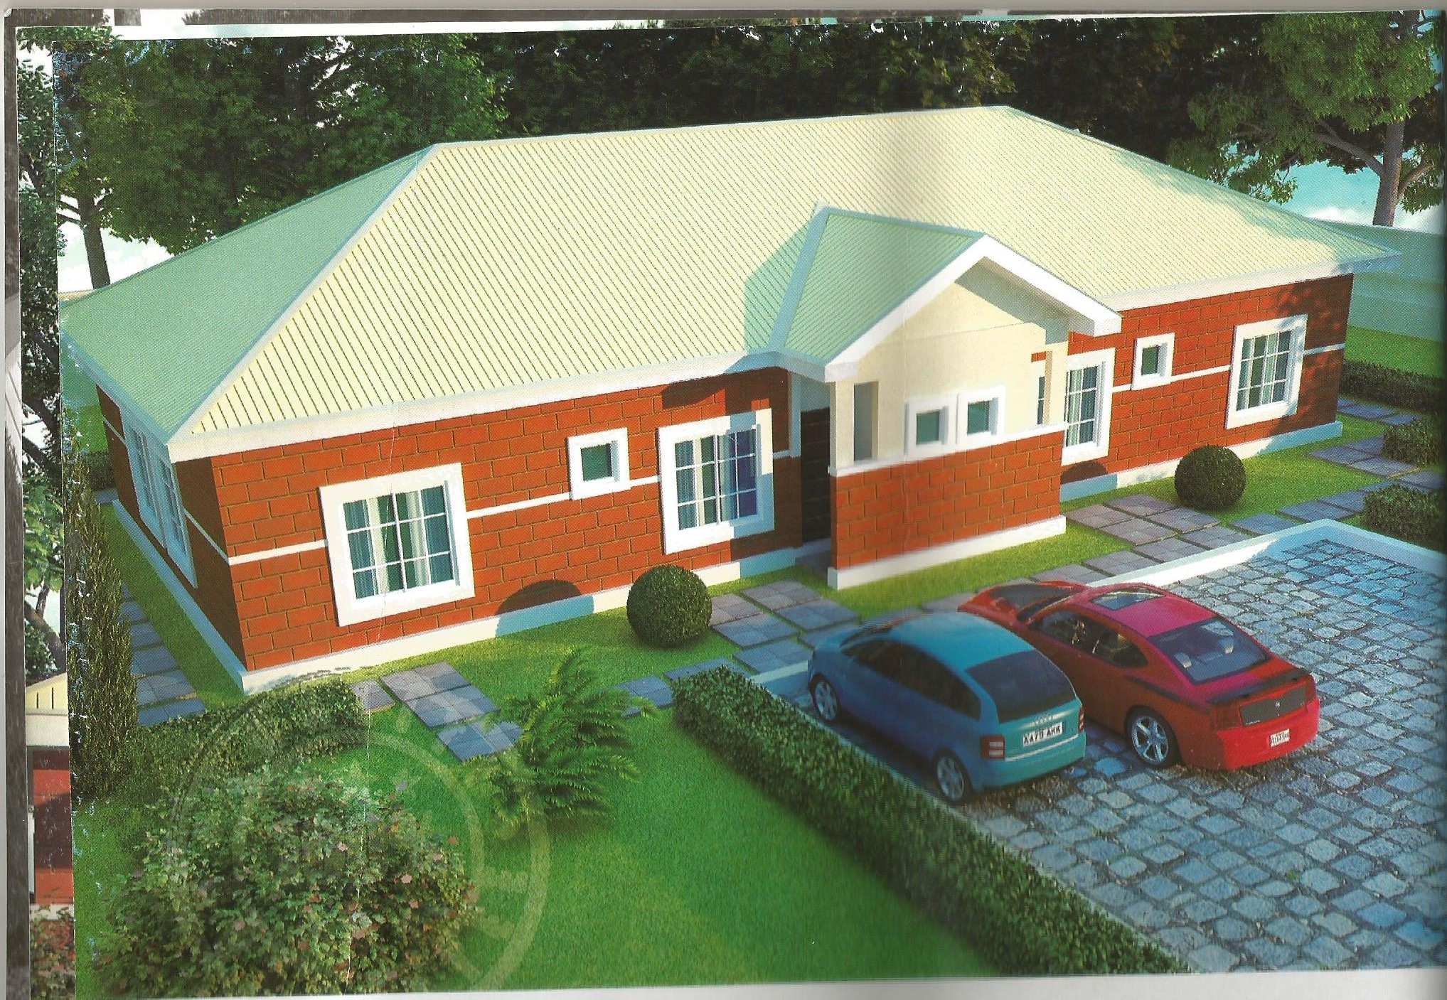
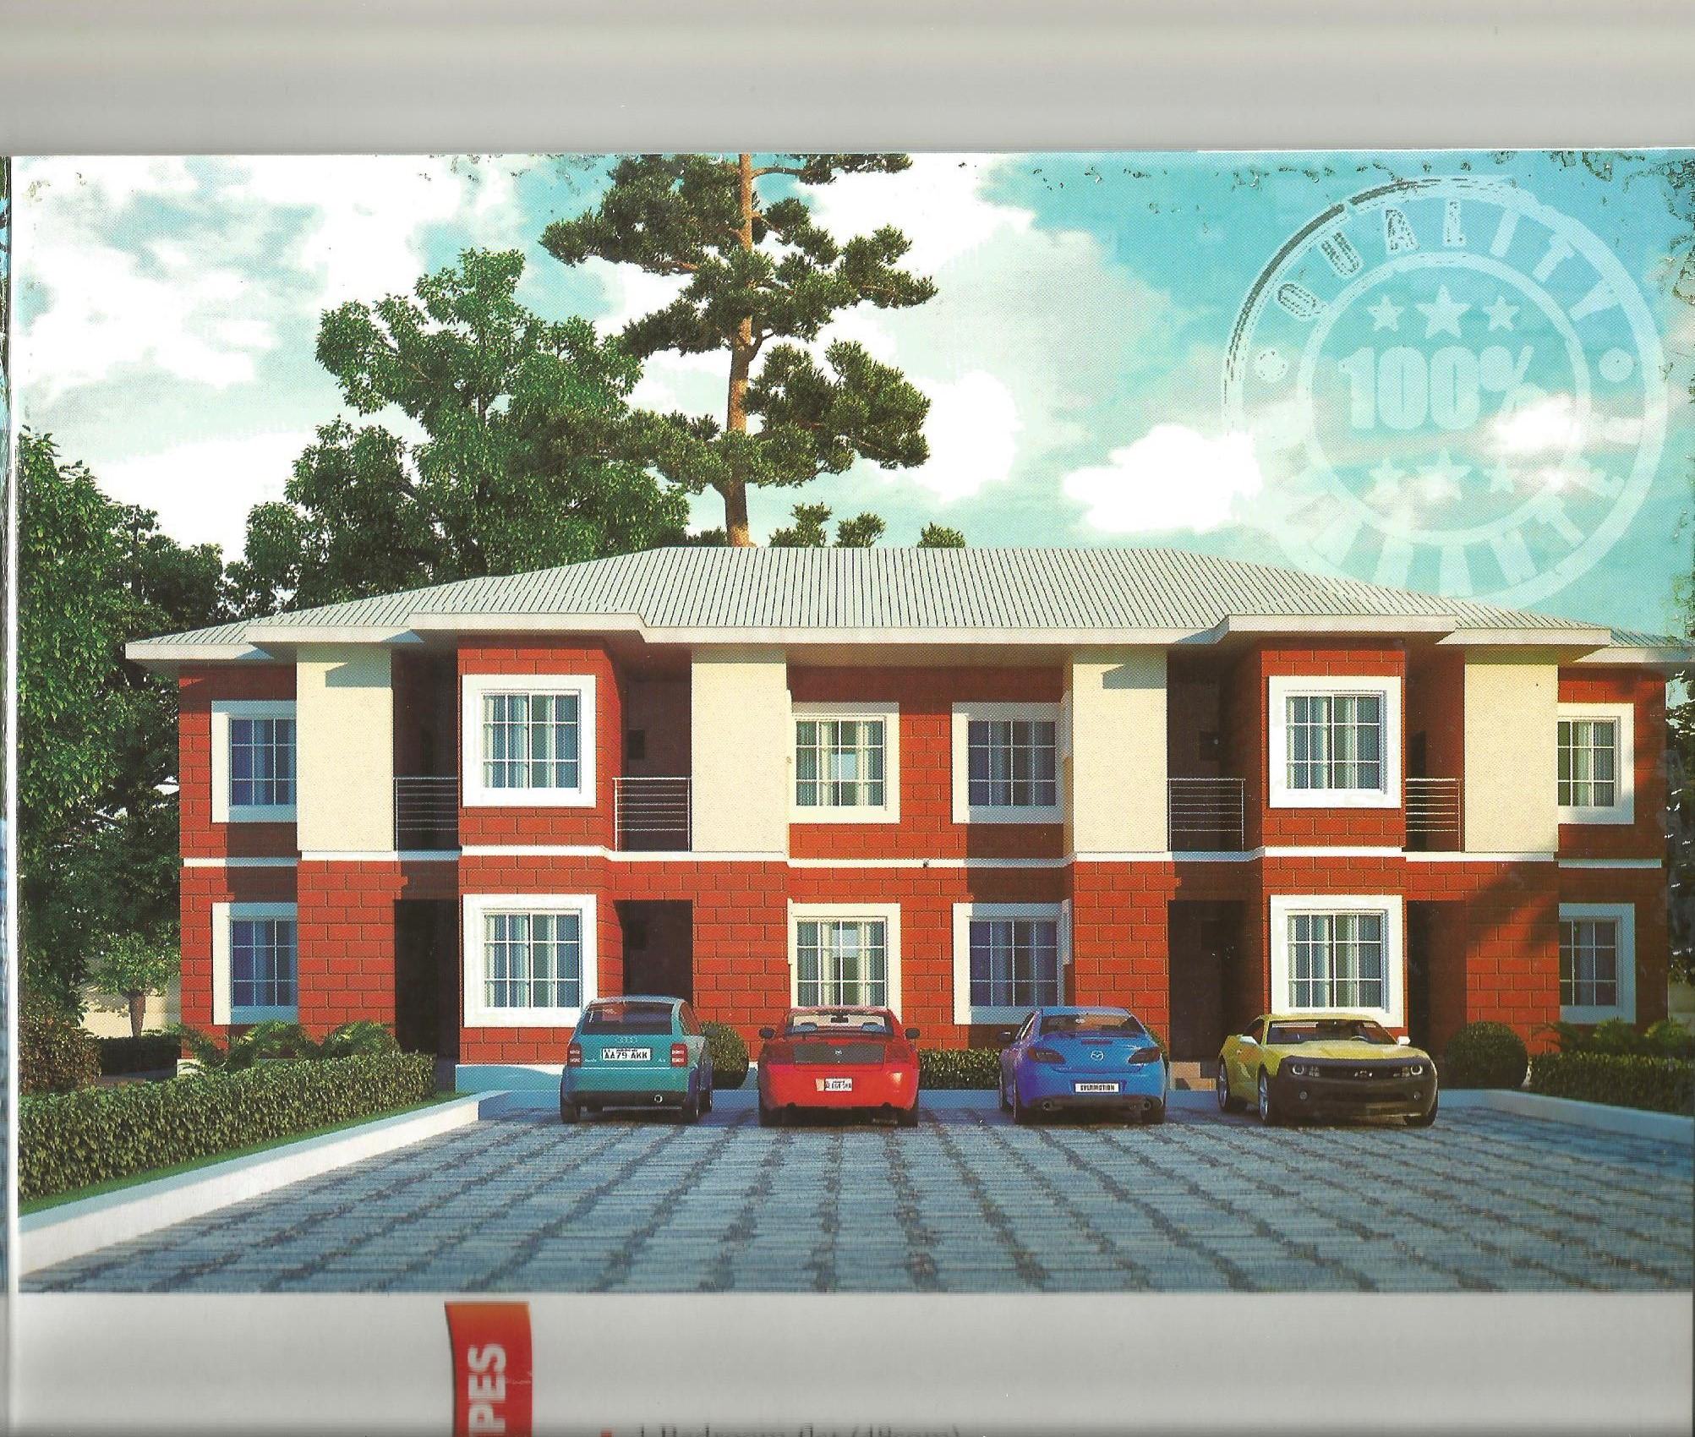
Technology
NHI
“Thinking Global, Acting Local”
12. The Brick City Abuja
An Indigenous wholly owned Nigerian company dedicated to the use of bricks
in the building of Affordable Houses in Nigeria.
© February 2016

Slide 30
Building Technology – Damdam Case Study – LAGOS HOMES, Ijora Badia, Lagos
NHI
“Thinking Global, Acting Local”
1008 units Affordable Social Mass Housing
Energy Efficiency
Provision of Land,
Infrastructure,
External works &
Maintenance
Mortgage Finance
© February 2016

Slide 31
Building Technology – GBI UK Case Study –Precast Concrete Construction Products
NHI
“Thinking Global, Acting Local”
Use of traditional quality of materials
Speed & Schedule delivery
Fast and efficient assembly on site
Competitive cost
Flexible design tailored to suit
Accurate Scheduling
Engineered to resist progressive collapse
Ease of design
Quality control
Flexible dimension
Reduce wastage and cost
Soundproof wall
© February 2016

Slide 32
Housing Finance
NHI
“Thinking Global, Acting Local”
© February 2016

Slide 33
Indicative Investment Requirements
NHI
“Thinking Global, Acting Local”
For 200,000 housing units (1st Phase)
Upon approval the initial funding would come based on the following:
Off taker deposits from 10%
Construction companies that have offered to finance and build
International financiers backed by a consortium of local commercial banks with guarantees as per attached documents.
One Bedroom – Bungalow, Terrace, Block of Flats and Condominiums;
    From N2.5million (Low Income)
Two & Three Bedrooms which comprises of Bungalows, Terraces, Block of Flats and Condominiums;
    From N3.5million (Medium Income)
Site and Services for High income customers and the General Public
© February 2016

Slide 34
Financing Options are...
NHI
“Thinking Global, Acting Local”
Development and Collaborative Model
A secured syndicated guarantee to access cheap funds from abroad – to edge out Forex risk or risk transfer to local banks;
Funds to be managed by Nigeria Banks.
© February 2016

Slide 35
Other Available Financing Options Upon Approval are...
NHI
“Thinking Global, Acting Local”
Offshore financing and DFIs such as
  European Economic Development Council such as Industrias Meracrop incorporated by Lancrest Construction Ltd
  FMO – Dutch Development Agency
  DEG – German Development Investment Bank
  European Investment Bank
  Islamic Corporation for the Development of Private Sector
  AFROEXIM -African Export Import Bank
  JICA – Japanese International Cooperation Agency
  The Kuwaiti Fund
  Shelter Afrique
  African Development Bank
  International Aid Agencies, Foundations, Trust and NGOs such as Bill & Mellinda Gates Foundation, Ford Foundation, Princess Trust, USAID, OPIC, DFID..ETC
© February 2016

Slide 36
Indicative list of FINANCE INSTITUTIONS/PARTNERS...please see the Appendix for details
NHI
“Thinking Global, Acting Local”
Lucot Group - Investment Banking and Finance, Fontvieille, Monaco - France
Titlas Global Consortium, Dubai - UAE
Washington Nationwide Mortgages Corporation -
HHB Consultants, Oxfordshire, United Kingdom
Goodwill Impex Group, Ikoyi, Lagos, Nigeria
Apec Logic Investment Limited, New South Wales, Australia
Nodaway Ltd - Utako, Abuja, Nigeria
TrustBond Mortgage Bank Plc
Greenwood Trading Inc.
The Hudson Consulting Group
BNBM House Company Ltd.
HHB Consultants
The general conditions for financing are:
3-6% pa interest rate inclusive of other local and sundry charges
15years minimum tenor
Provision of syndicated bank guarantee or sovereign guarantee and/or indemnity insurance
90days Turnaround time upon the receipt of the required guarantee
© February 2016

Slide 37
Marketing & Sales
NHI
“Thinking Global, Acting Local”
© February 2016

Slide 38
Our target markets would include.....
NHI
“Thinking Global, Acting Local”
Informal Income Earners – Mostly market women, peasant farmers/traders, taxi drivers, food sellers, Artisans or those living on a daily income, and under cooperatives
Formal Income Earners
  Low Income Earners
  Medium Income Earners
  High Income Earners
© February 2016

Slide 39



Our Marketing Approach would be based on a fully integrated platform as shown.....
NHI
“Thinking Global, Acting Local”
3D Animated Videos
Mobile Applications
Print & Electronic Media
Internet
© February 2016

Slide 40
Proposed Marketing Management Structure
NHI
“Thinking Global, Acting Local”
State Marketing Managers
General Manager – Marketing & Business Development
Development Partners
Offakers
Estate Development Companies
Realtors
Primary Mortgage Institutions (PMIs)
Property Agents
Co-operatives
  MDAs
  National Assembly
  The Police. Armed Forces, and Paramilitary (Customs, Immigration, Prisons and Civil Defence
  Banks and Other Financial Insttituions
  Insurance Companies
  FAAN
  EFCC and ICPC
  NIA and DSS
  Nigerians in Diaspora
  General Public
Assistant Managers/Managers
Chief Marketing & Business
Development Officer
Marketing/Sales Executives
Regional AGM
Marketing/Sales Officers
© February 2016

Slide 41
Implementation Plan
NHI
“Thinking Global, Acting Local”
© February 2016

Slide 42
Recommendations For Government To Ease Housing Delivery
NHI
“Thinking Global, Acting Local”
Policy and Regulatory reform in Nigeria mortgage system;
  Private sector drive mortgage intervention system
Nationwide affordable housing scheme;
Capacity building and skill acquisition centres for housing development;
Favourable tax regime for locally manufactured building materials;
Reform the National Housing Fund for easy access to mortgages;
Pension funds intervention in the housing sector;
Waivers, Interest rate, Import duty, and taxation
Tax incentives and concessions for large scale housing; and
Enforcement of building code to forestall use of substandard building materials
© February 2016

Slide 43
NHI proposal to FGN are....
NHI
“Thinking Global, Acting Local”
Provision of a Minimum of Two Hundred Thousand Housing Units nationwide within the tenure of this administration;
  In line with the FGN Housing aspirations
  To target all income classes
  House design would incorporate family size, ethno-religious, cultural and socio-economic background of the people
  Undertake, through an enumeration survey, population density migration figures in each state would be used for the purposes of planning
  Intervention through our unique module –
  PUBLIC-PRIVATE-PARTNERSHIP
  Provsion of adequate Infrastructure and Social Amenities
Encourage the use of Nigerian Local Contractors
  For Employment Generation
  Skills acquisition – Carpentary, Plumbing, Tilling, Painting, Electrical, Maisonary....etc
  Economic Empowerment
  Locally Sourced Building Materials
© February 2016

Slide 44
Request
NHI
“Thinking Global, Acting Local”
© February 2016

Slide 45
Request
NHI
“Thinking Global, Acting Local”
FG/State/Local Government Support for the provision of Land, Infrastructure, Off-takers and Financial Guarantees from Nigerian Primary Mortgage Institutions (PMI).
To approve this effort to be carried out as a registered Foundation by the name of;
    NATIONAL HOUSING INITIATIVE FOUNDATION (NHIF)
© February 2016

Slide 46
Appendix
NHI
“Thinking Global, Acting Local”
© February 2016

Slide 47
NHI
“Thinking Global, Acting Local”
Thank you.
We look forward to working with you
© February 2016

Slide 48
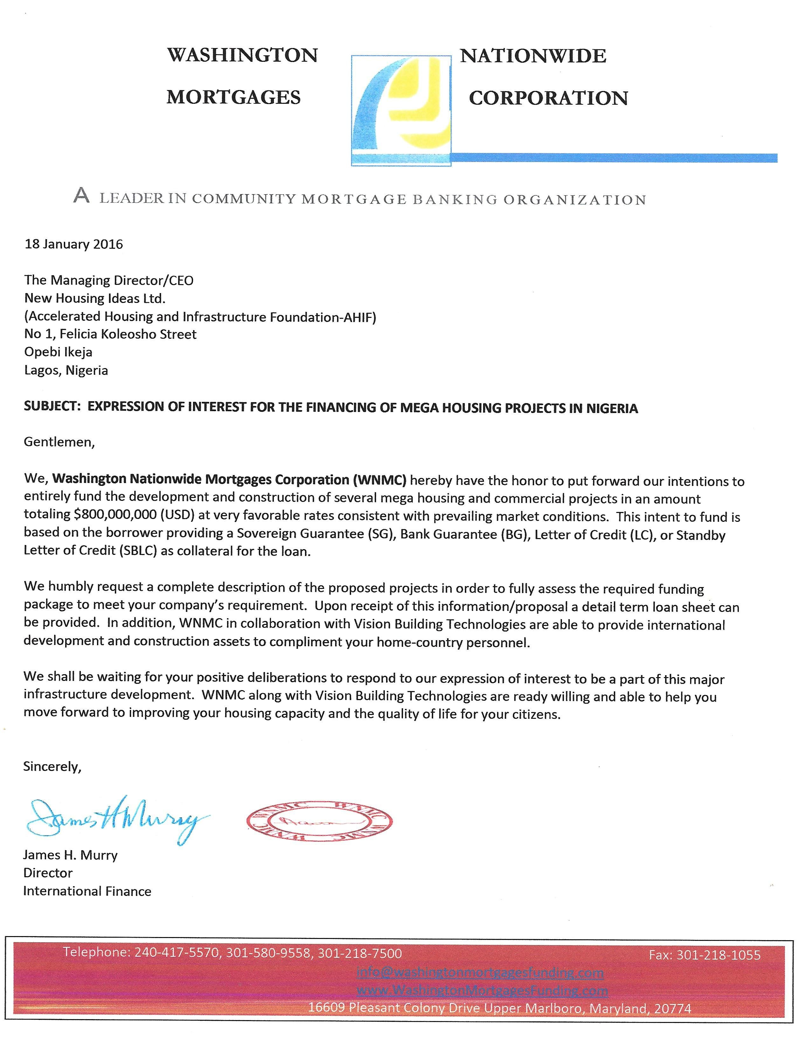
EXPRESSION OF INTEREST LETTERS
NHI
“Thinking Global, Acting Local”
© February 2016

Slide 49
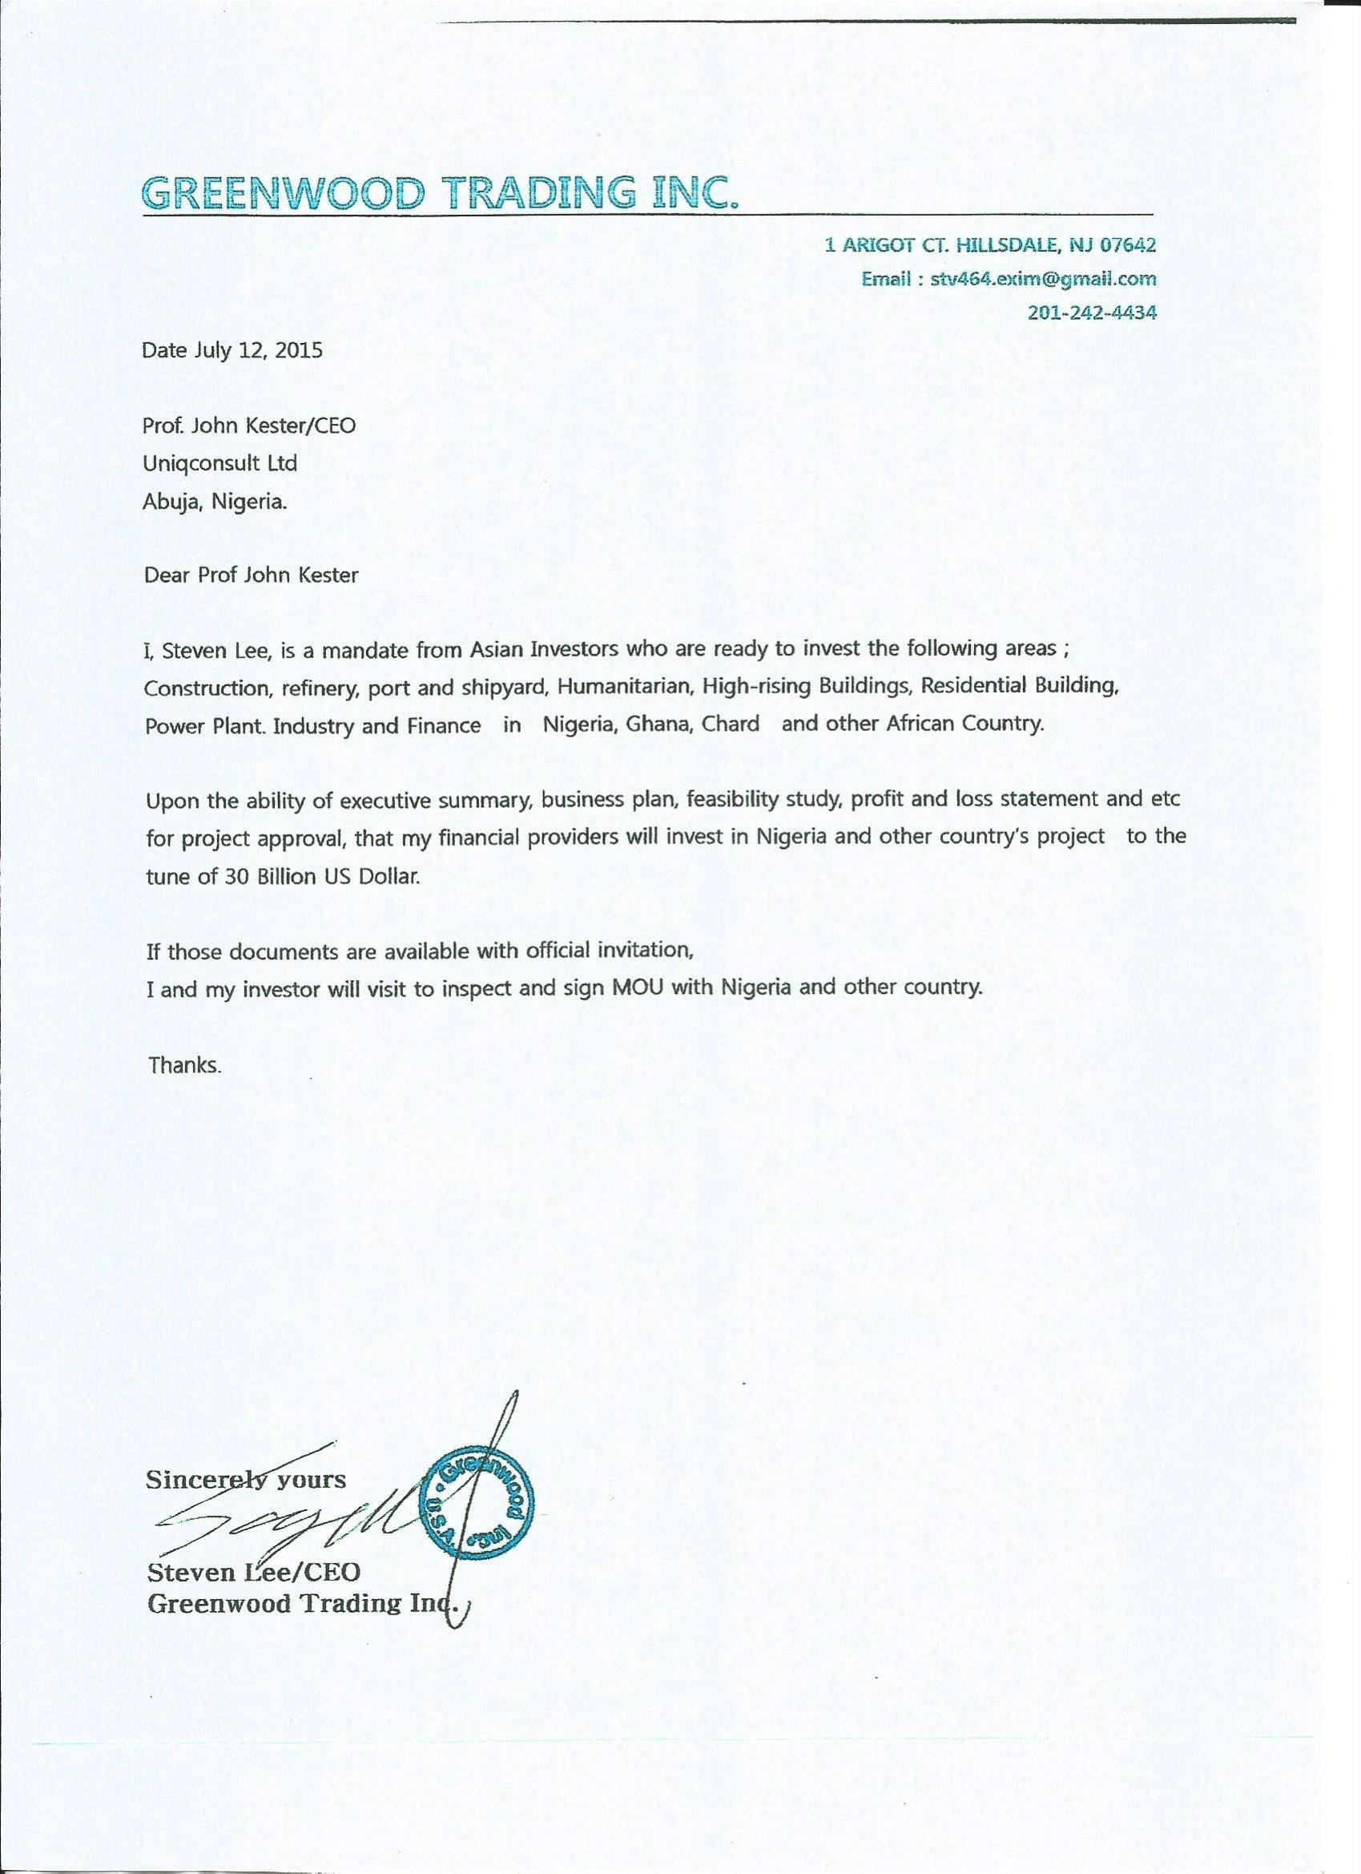
NHI
“Thinking Global, Acting Local”
© February 2016

Slide 50
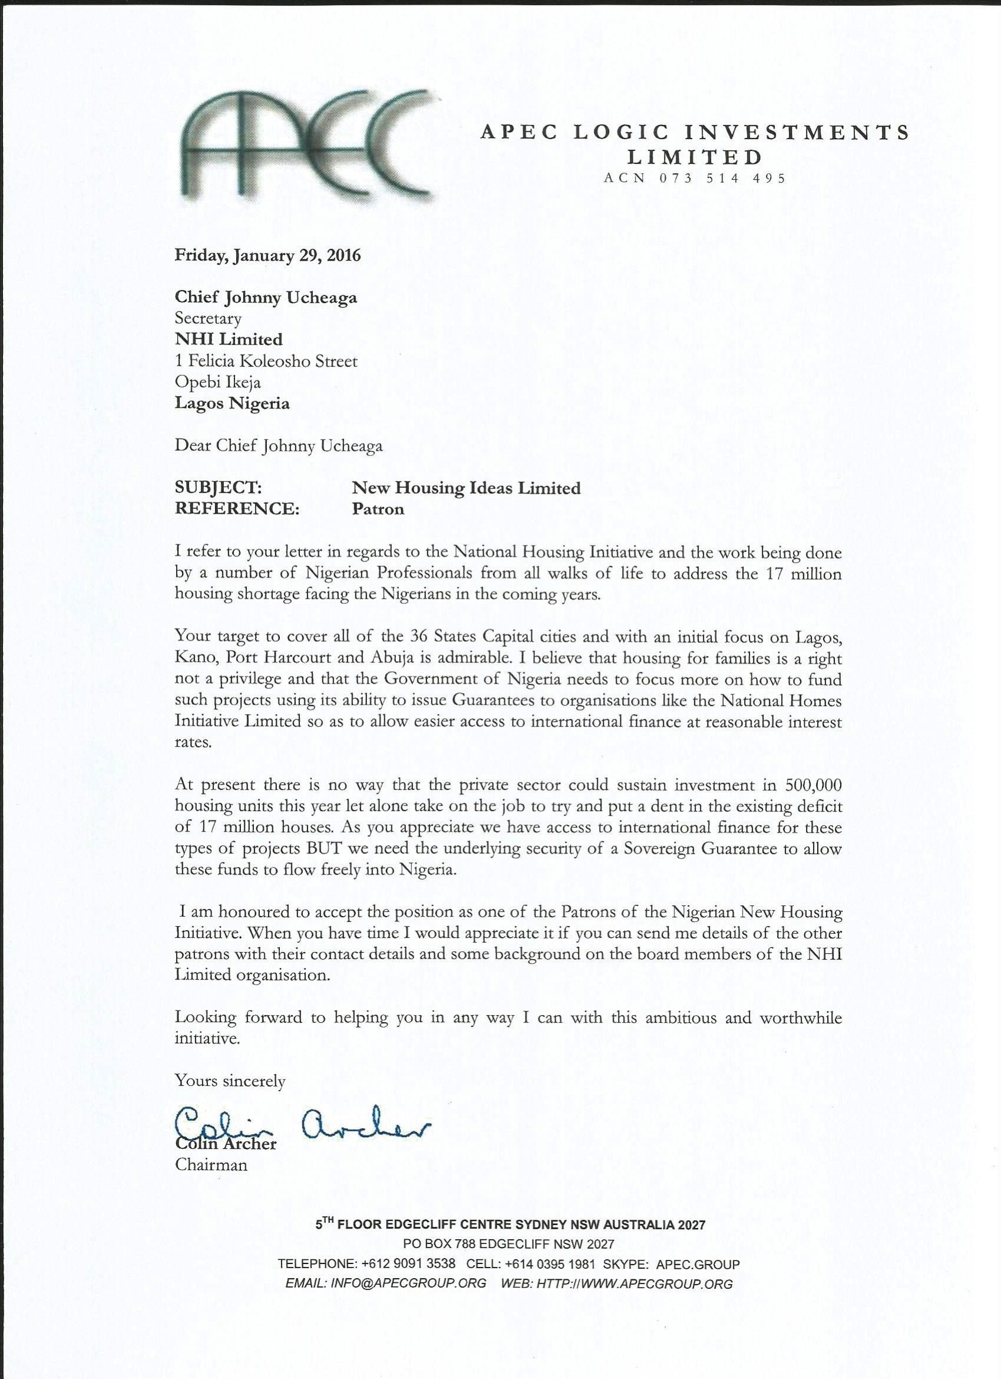
NHI
“Thinking Global, Acting Local”
© February 2016

Slide 51
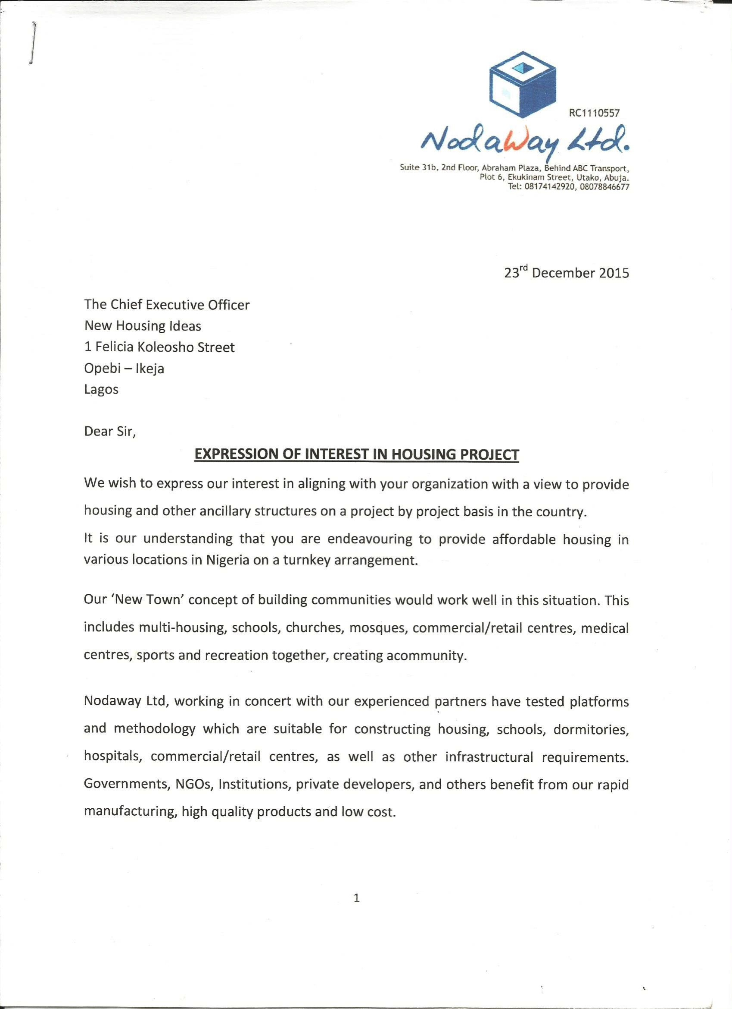
NHI
“Thinking Global, Acting Local”
© February 2016

Slide 52
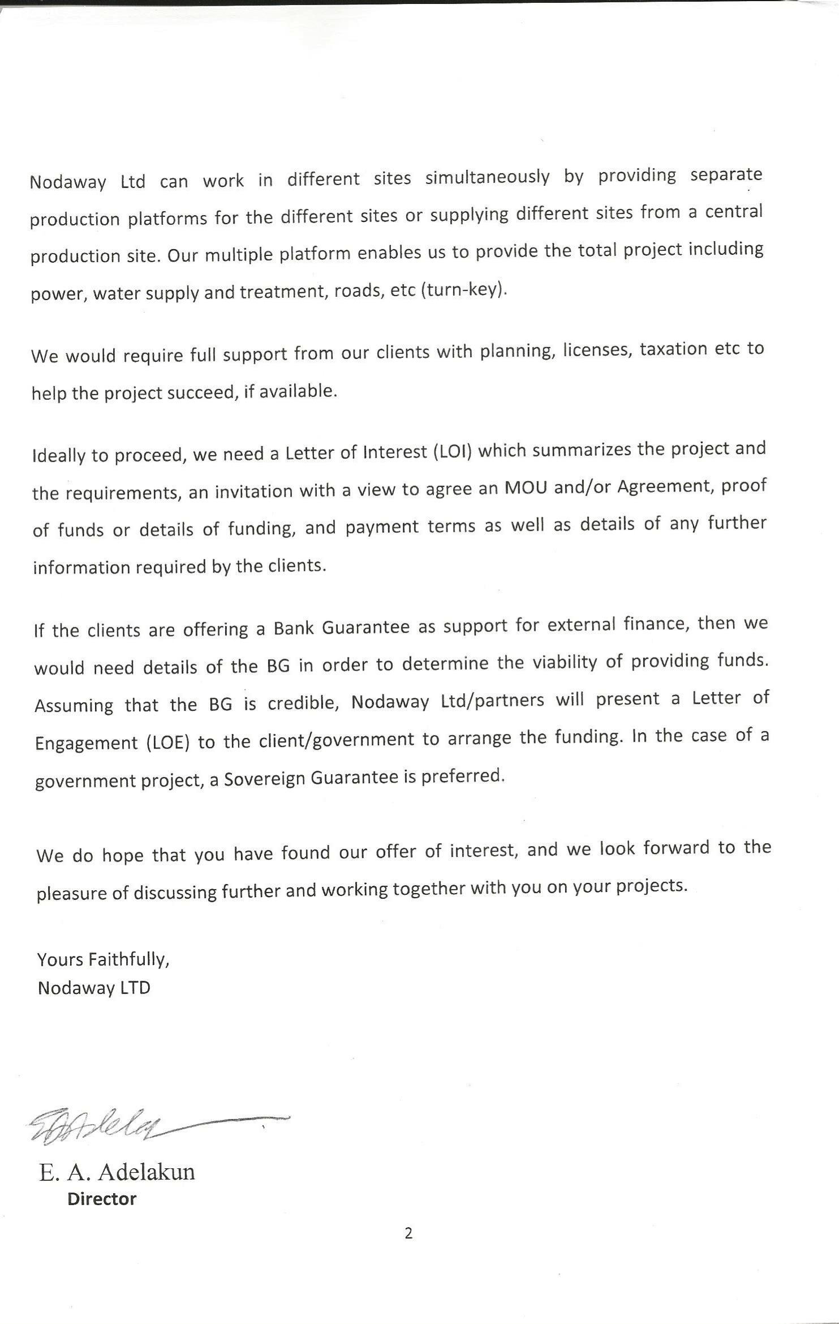
NHI
“Thinking Global, Acting Local”
© February 2016

Slide 53
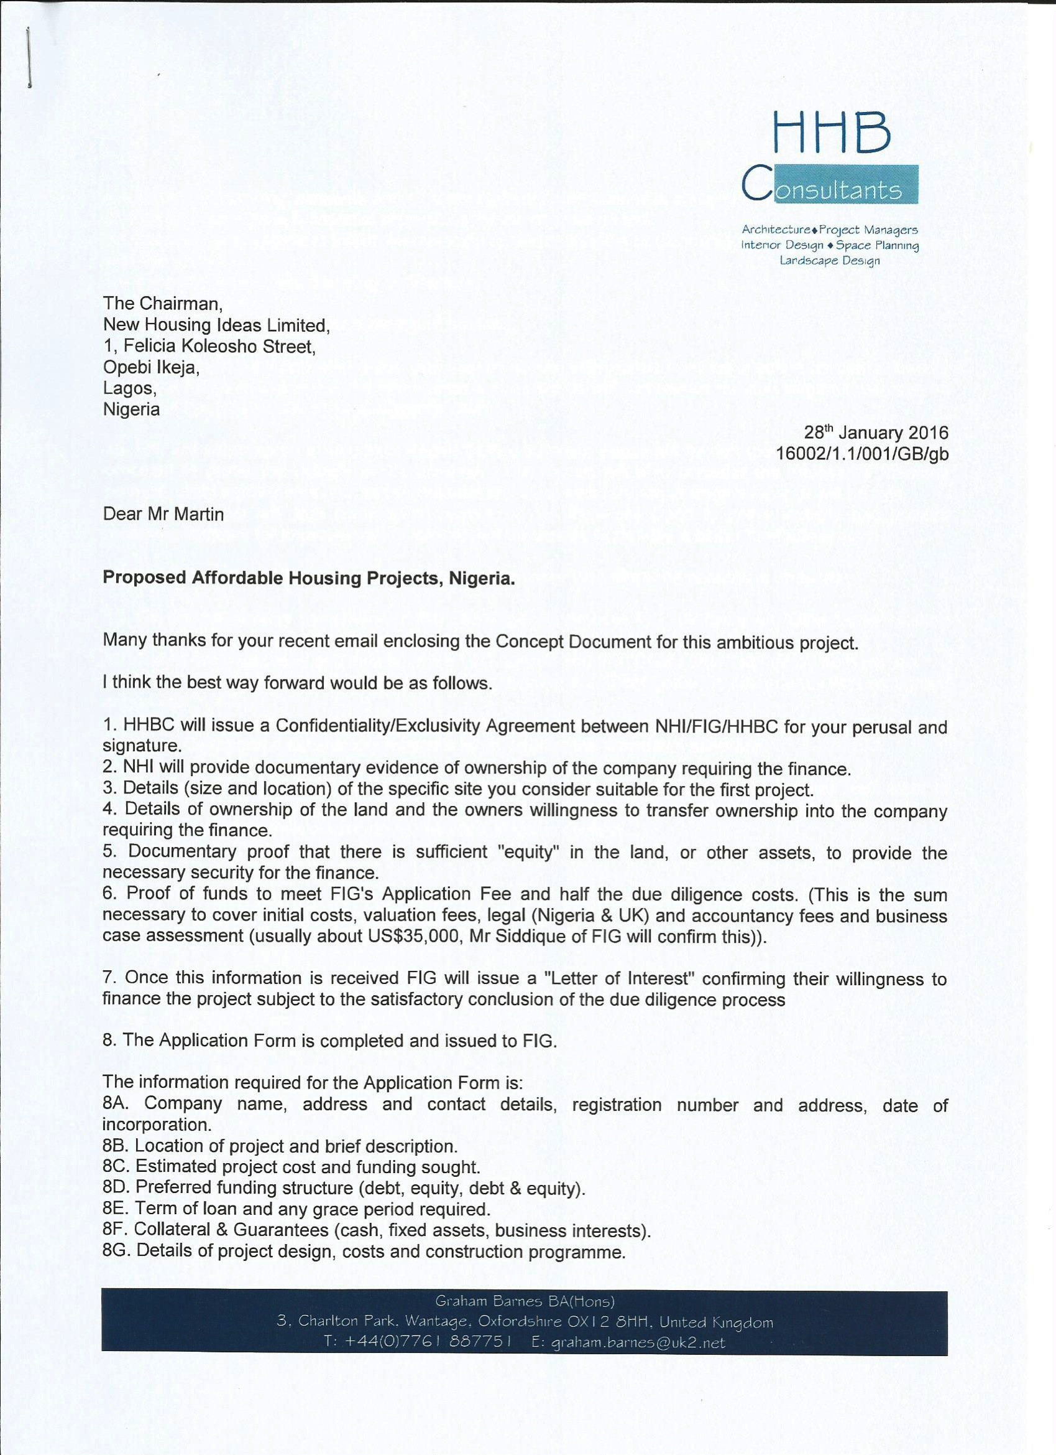
NHI
“Thinking Global, Acting Local”
© February 2016

Slide 54
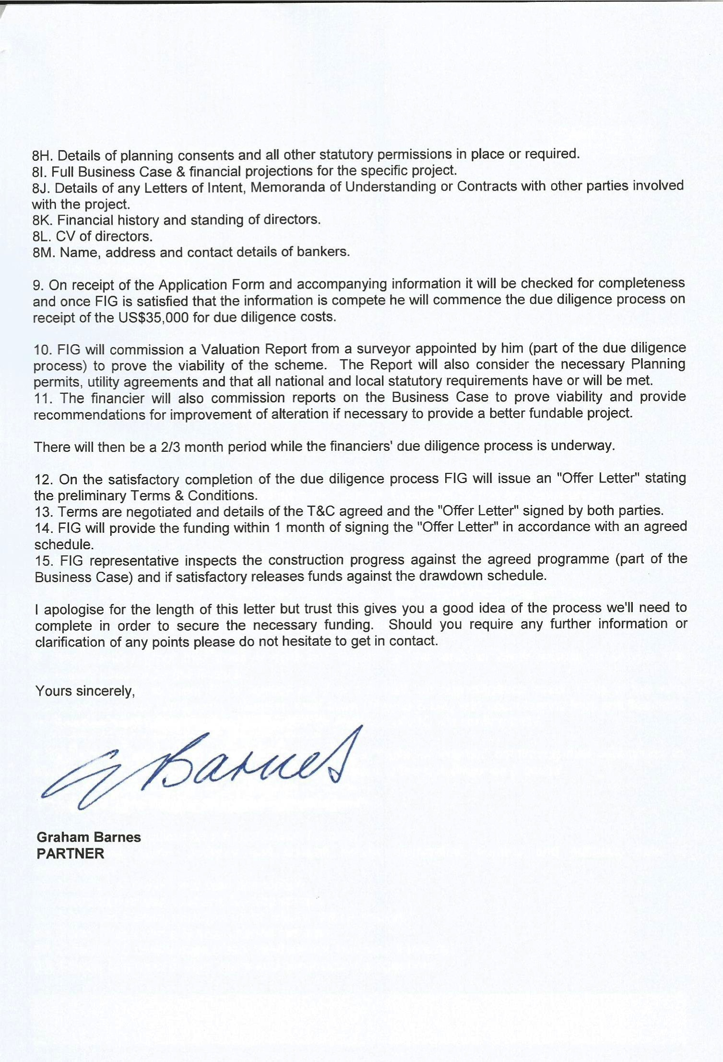
NHI
“Thinking Global, Acting Local”
© February 2016

Slide 55
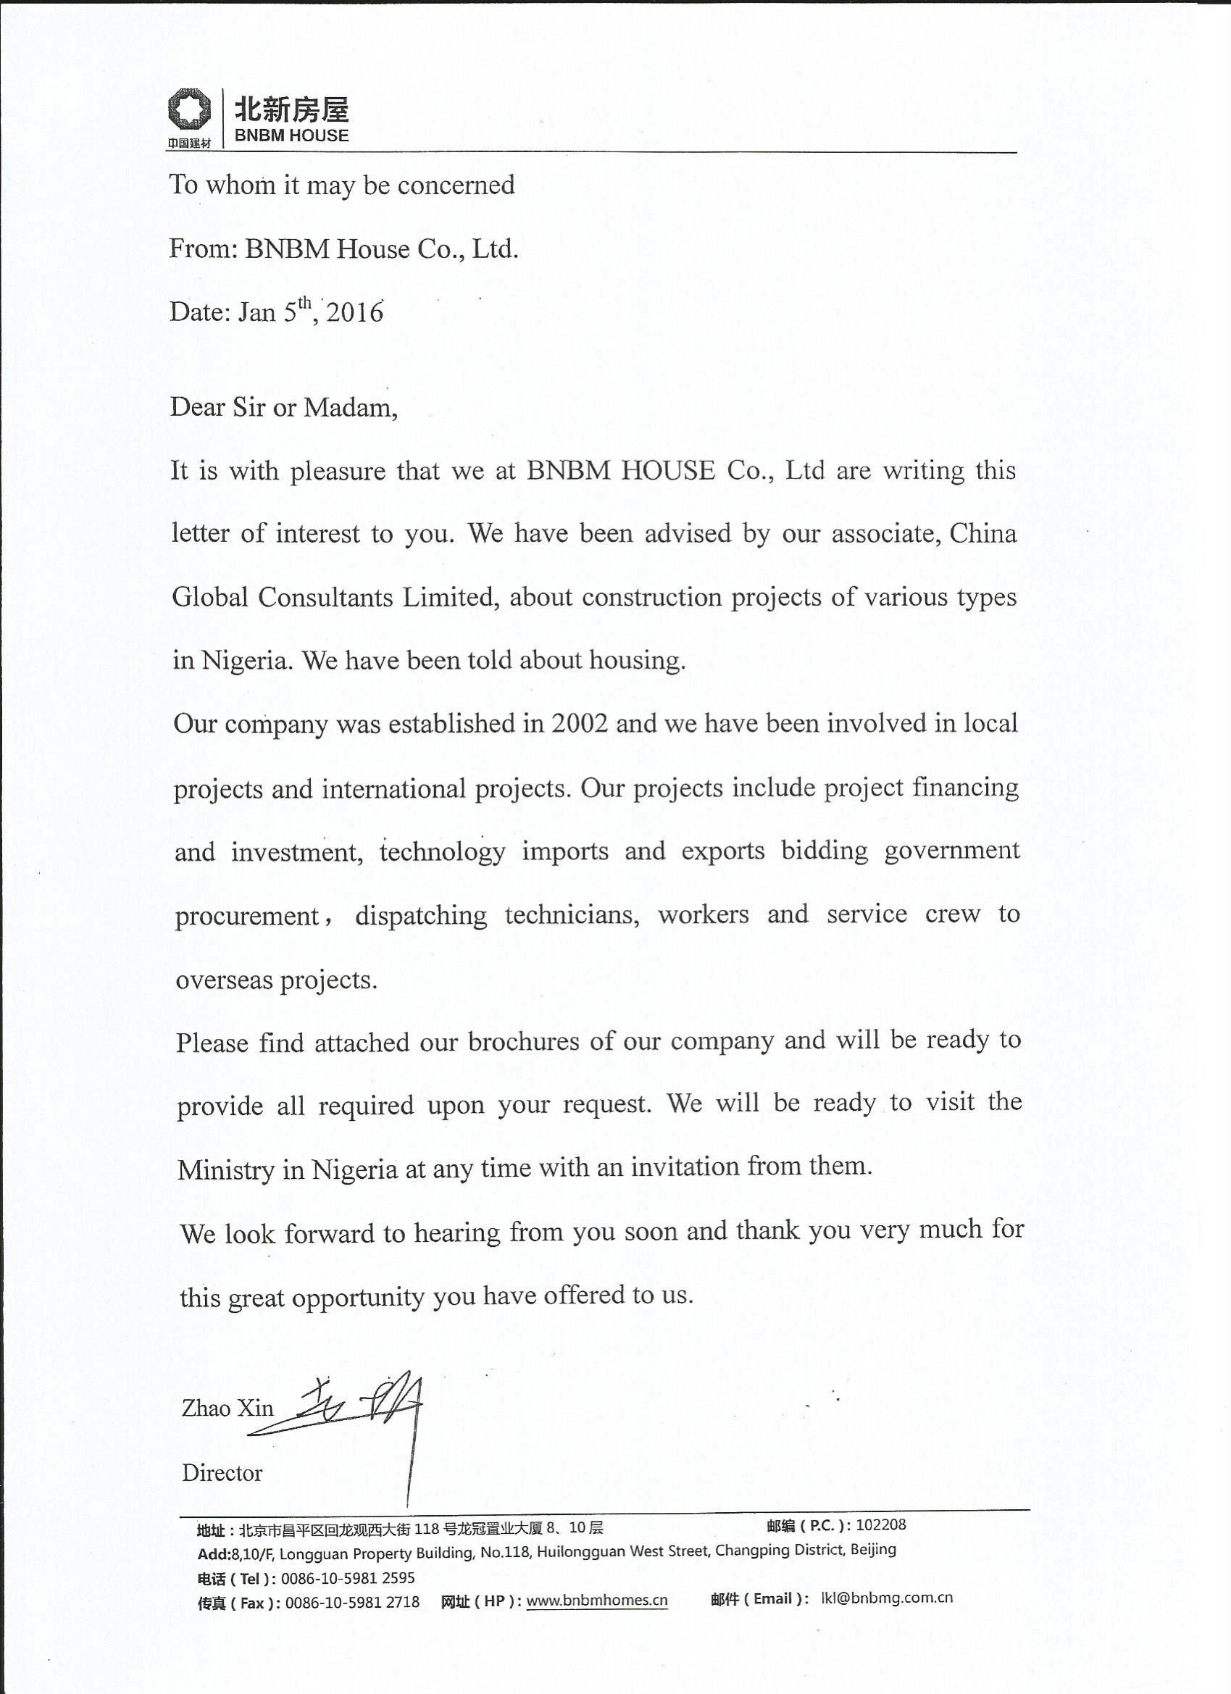
NHI
“Thinking Global, Acting Local”
© February 2016

Slide 56
NHI
“Thinking Global, Acting Local”
© February 2016

Slide 57
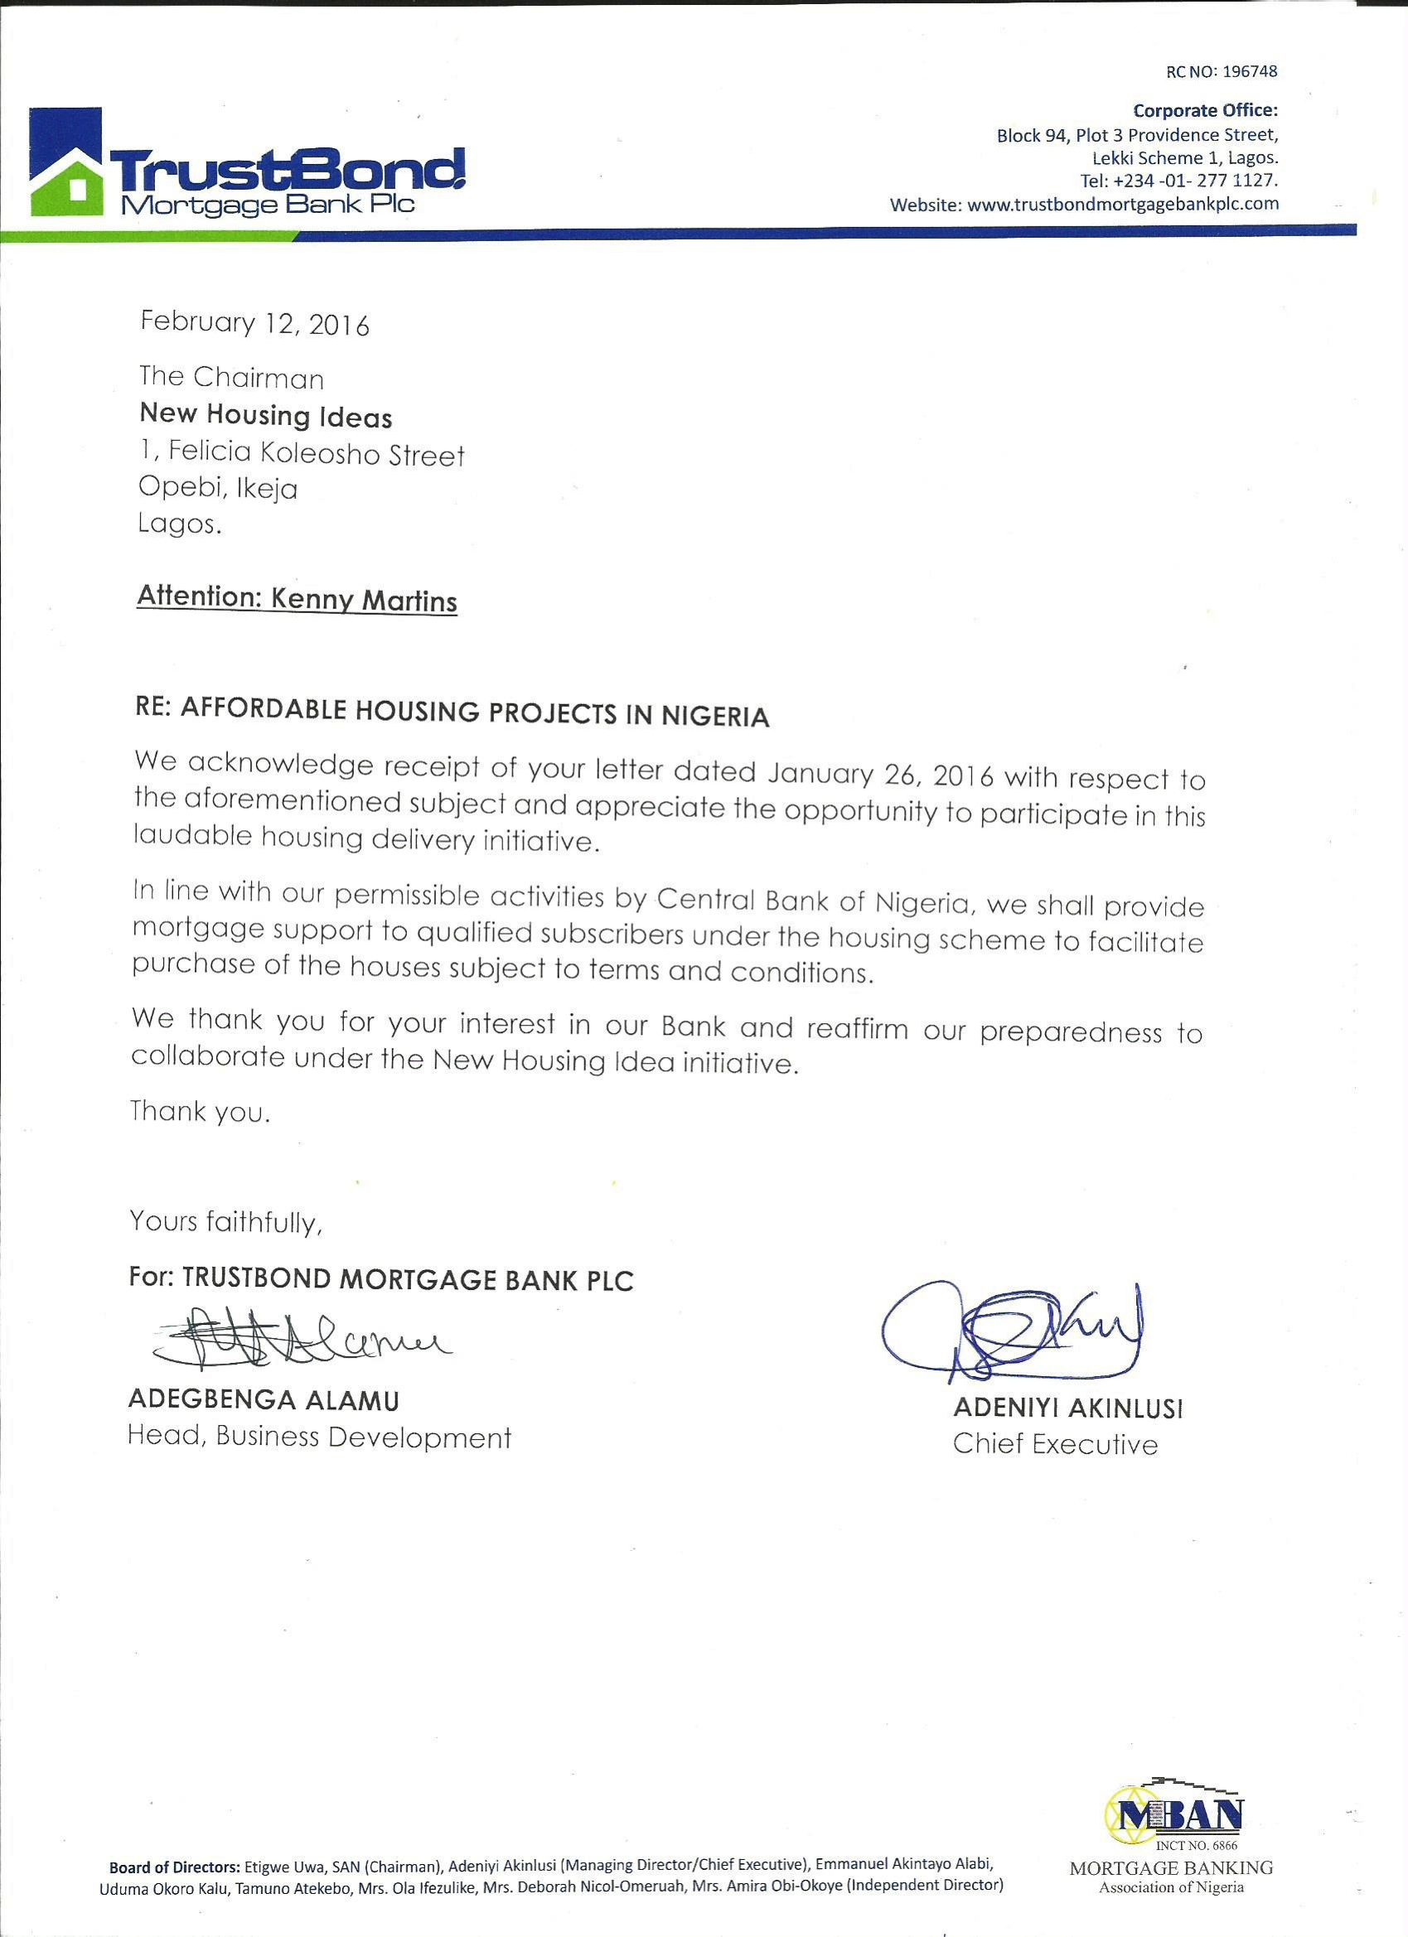
NHI
“Thinking Global, Acting Local”
© February 2016

Slide 58
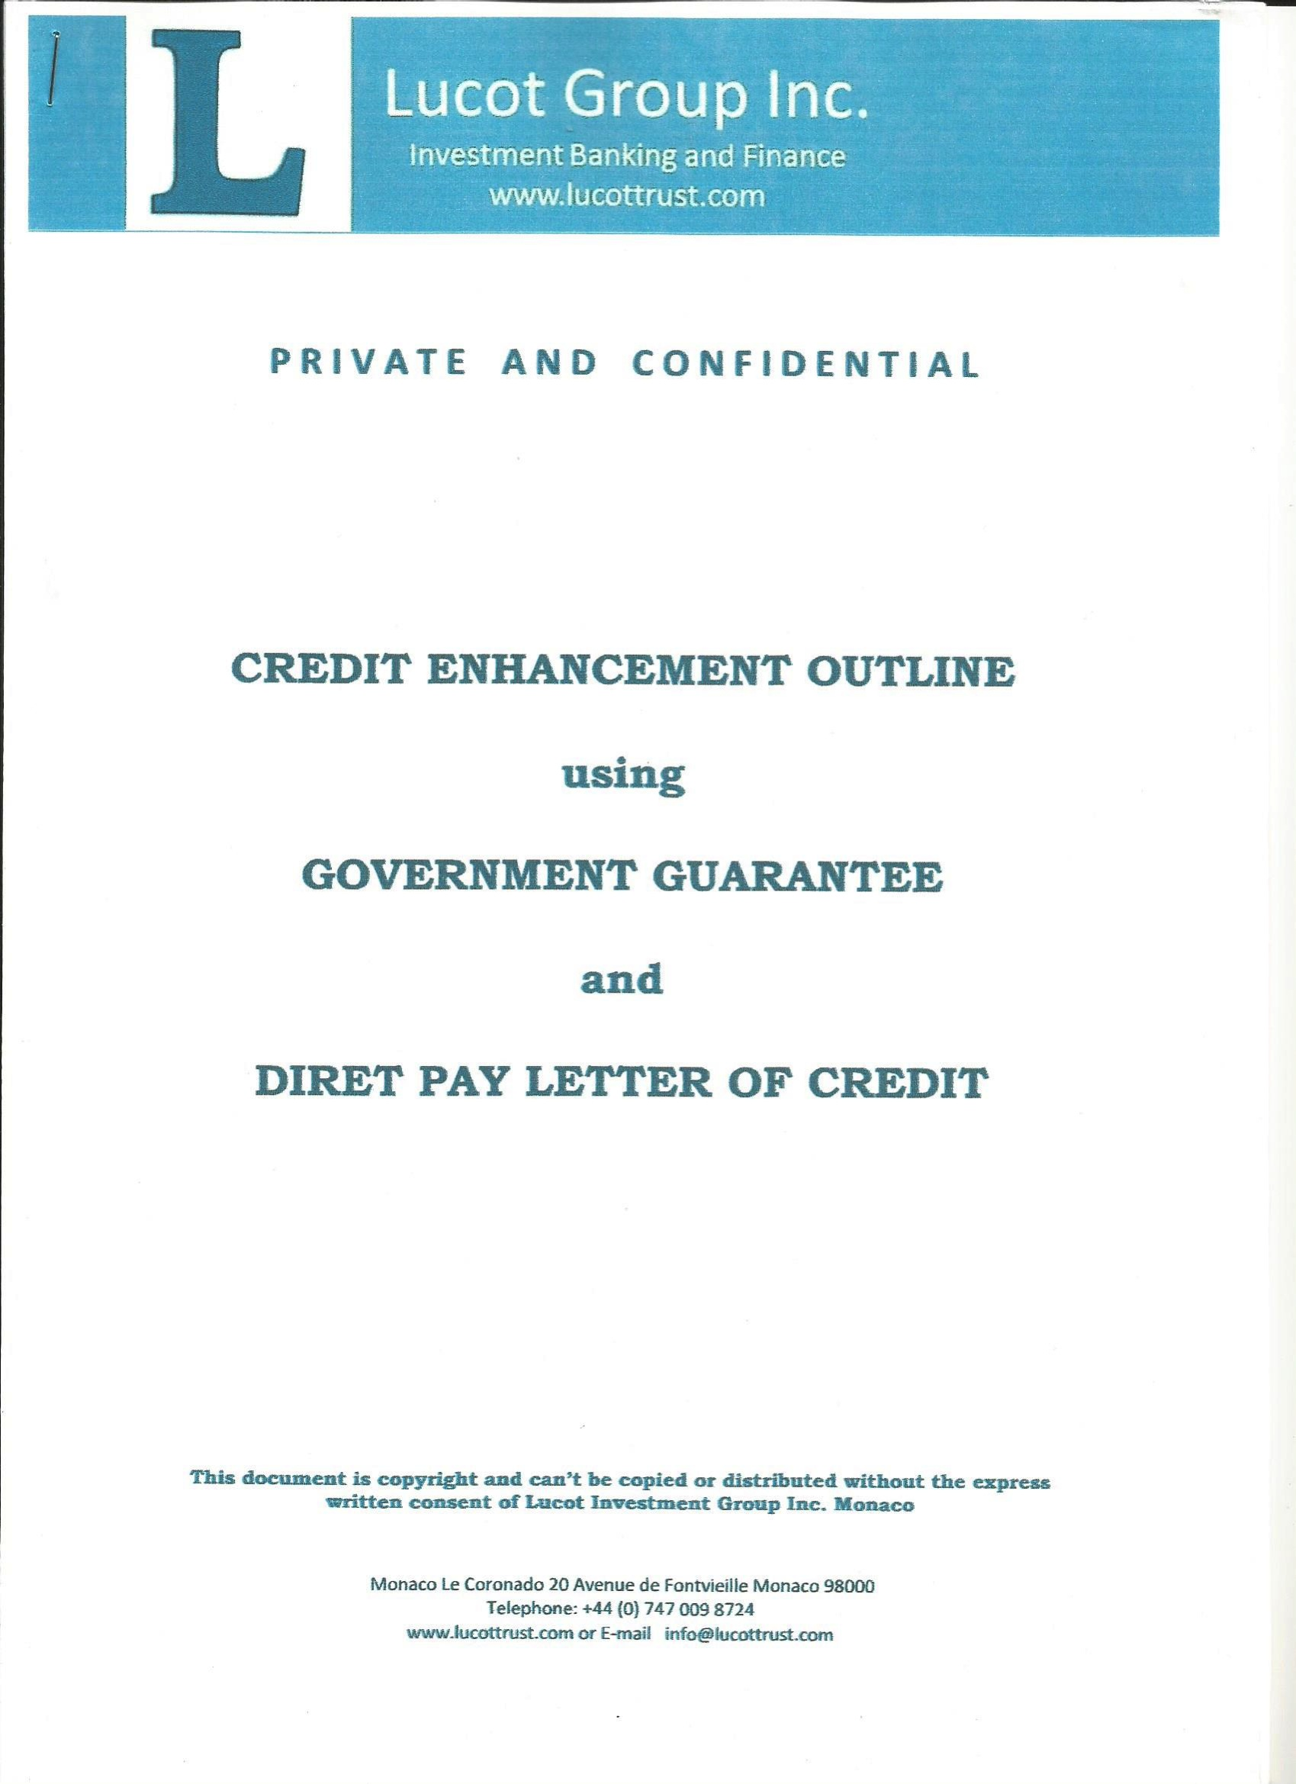
NHI
“Thinking Global, Acting Local”
© February 2016

Slide 59
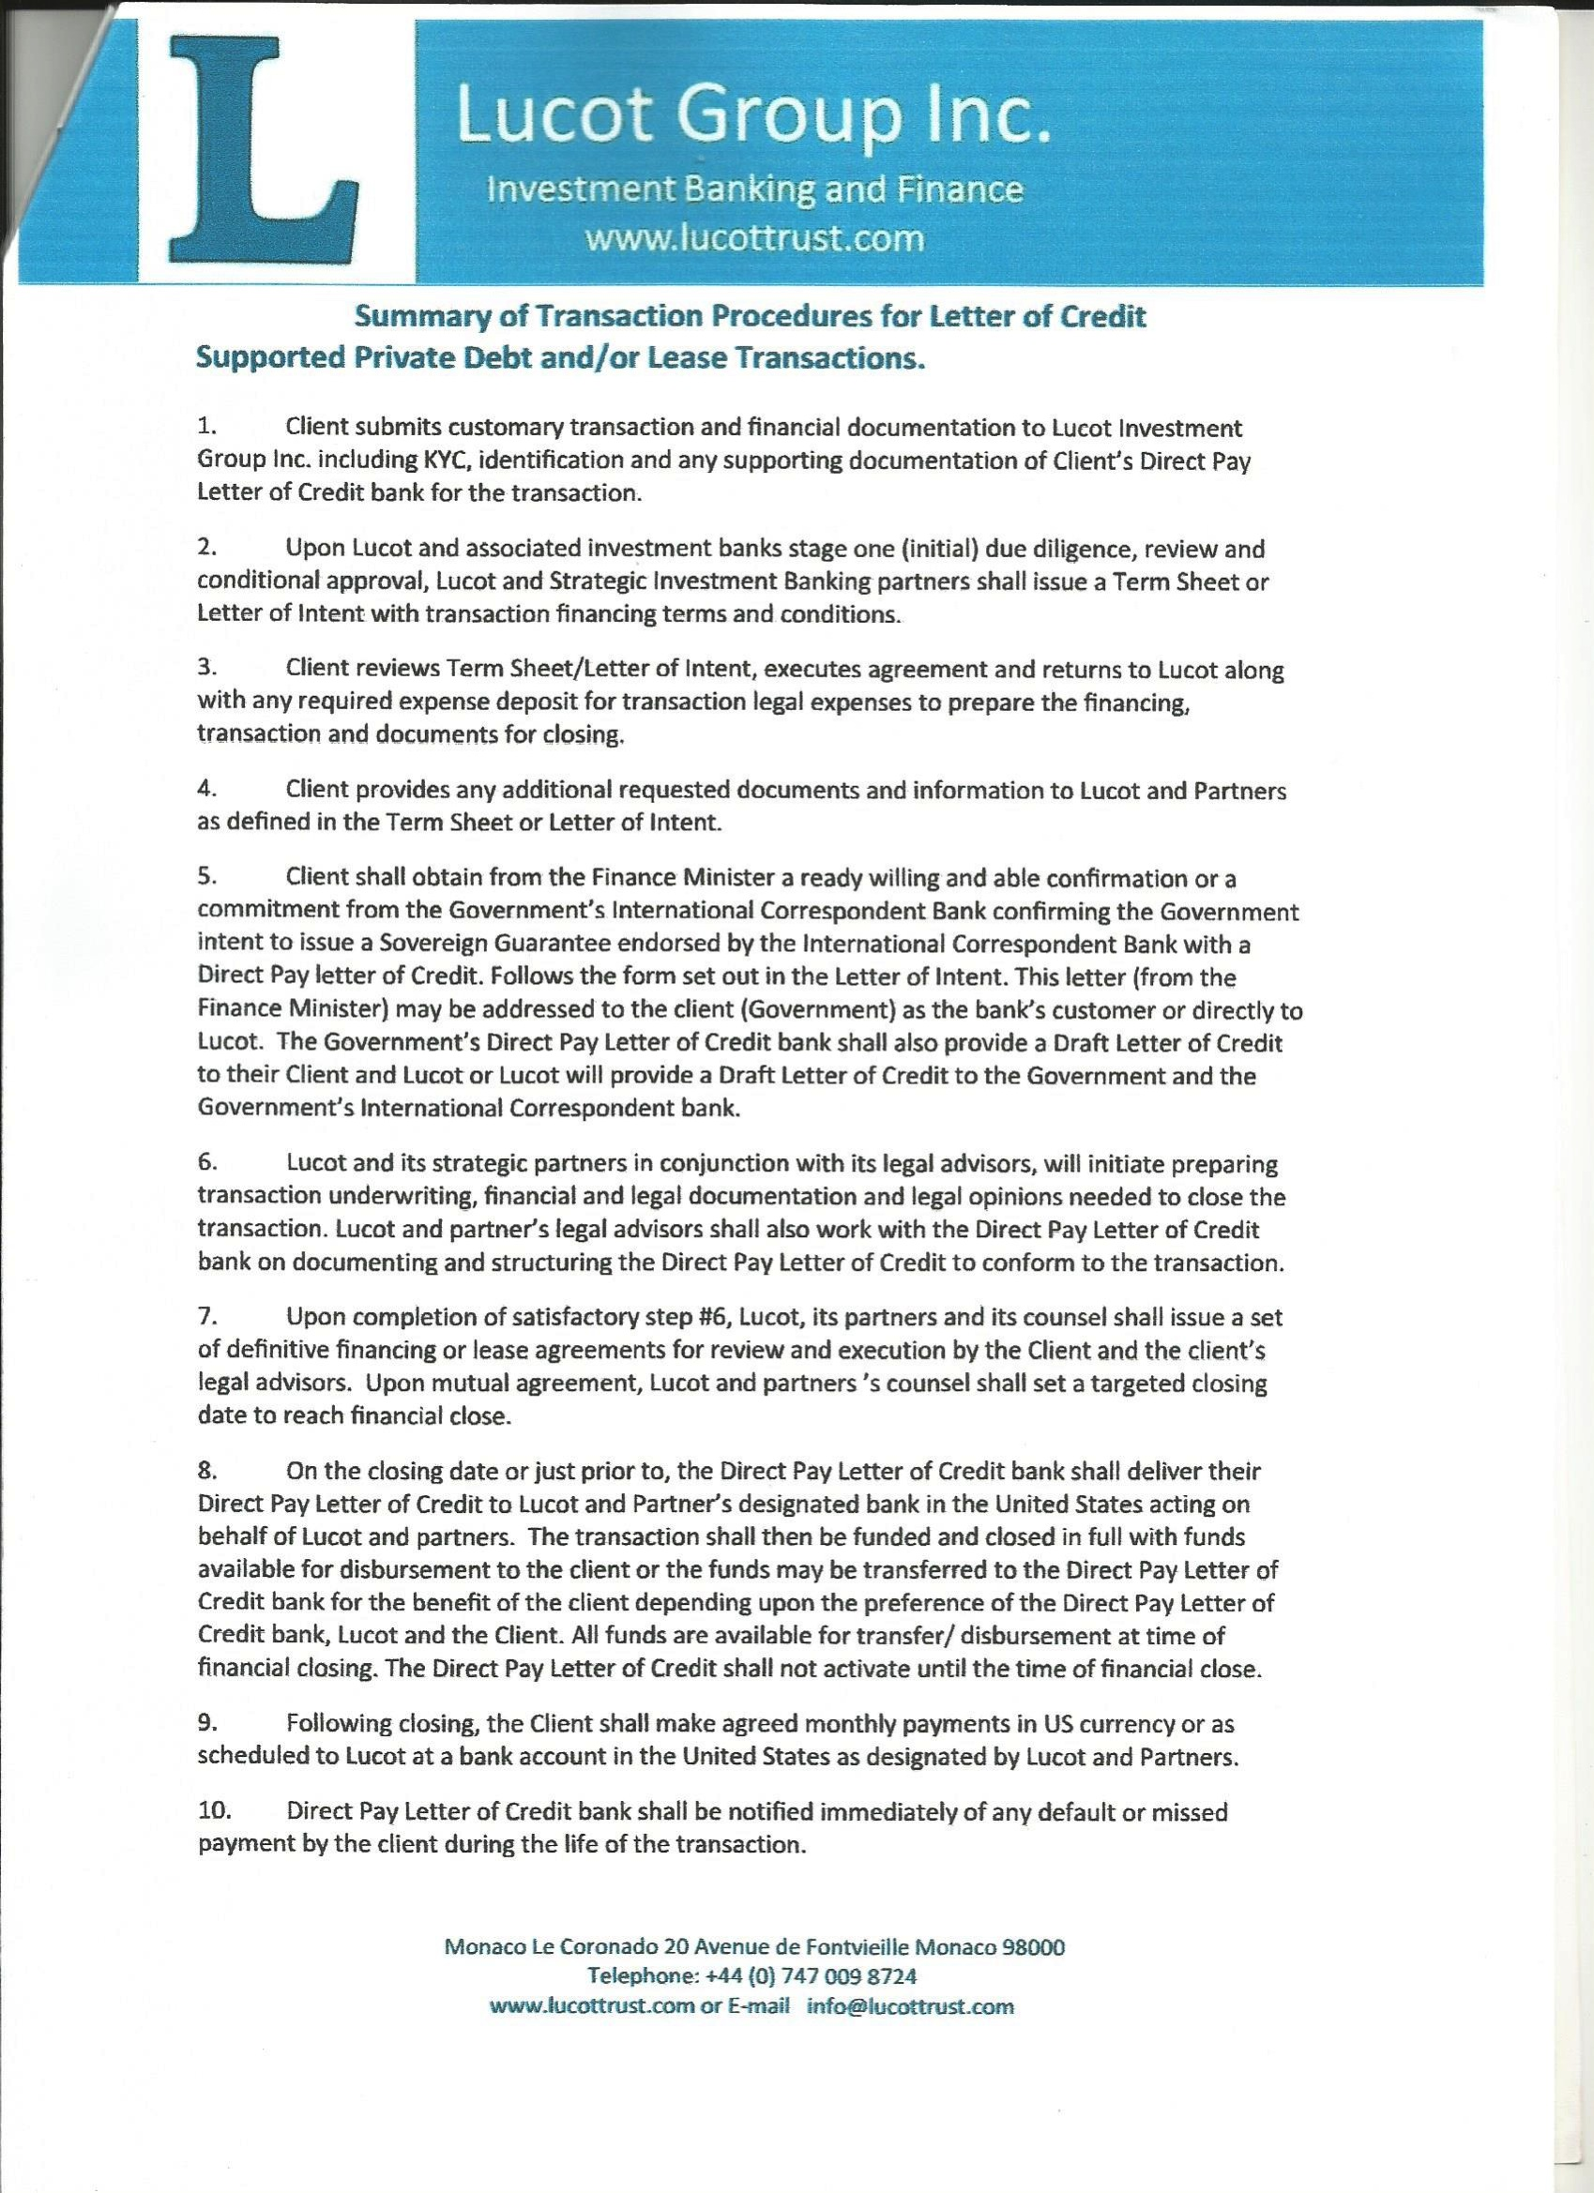
NHI
“Thinking Global, Acting Local”
© February 2016

Slide 60
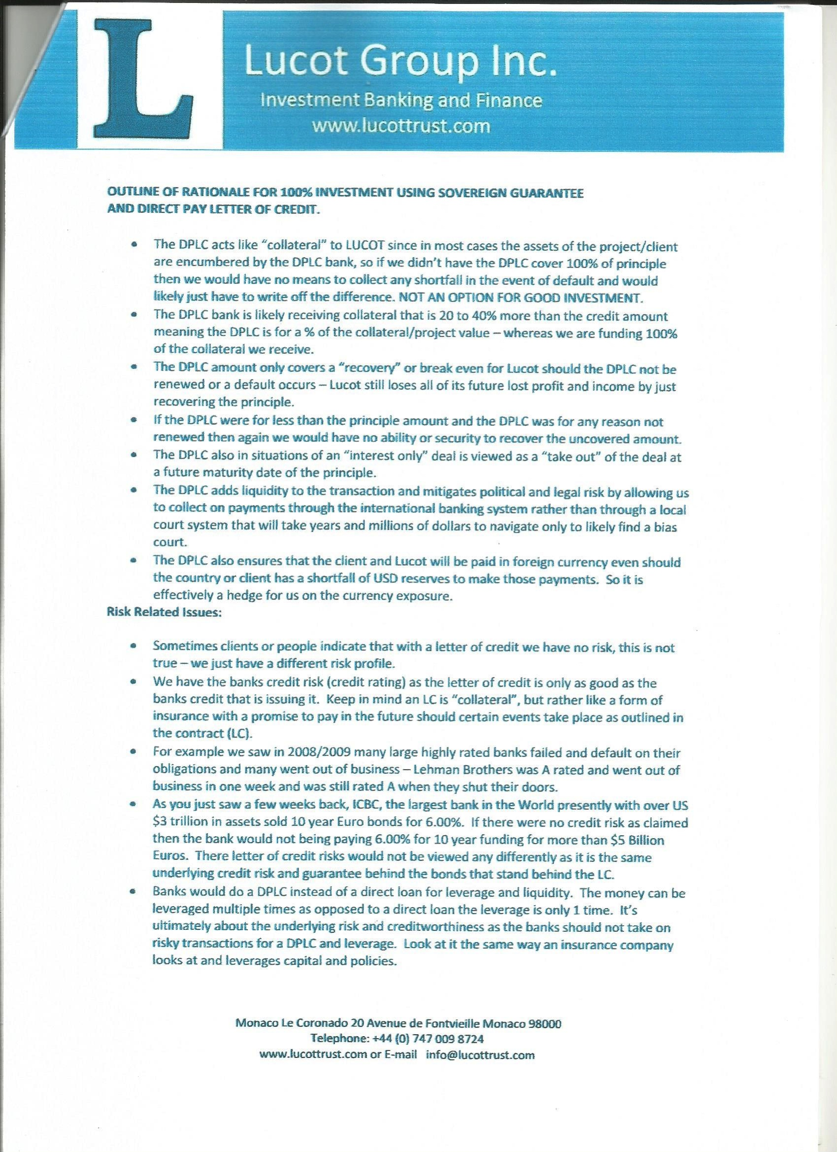
NHI
“Thinking Global, Acting Local”
© February 2016

Slide 61
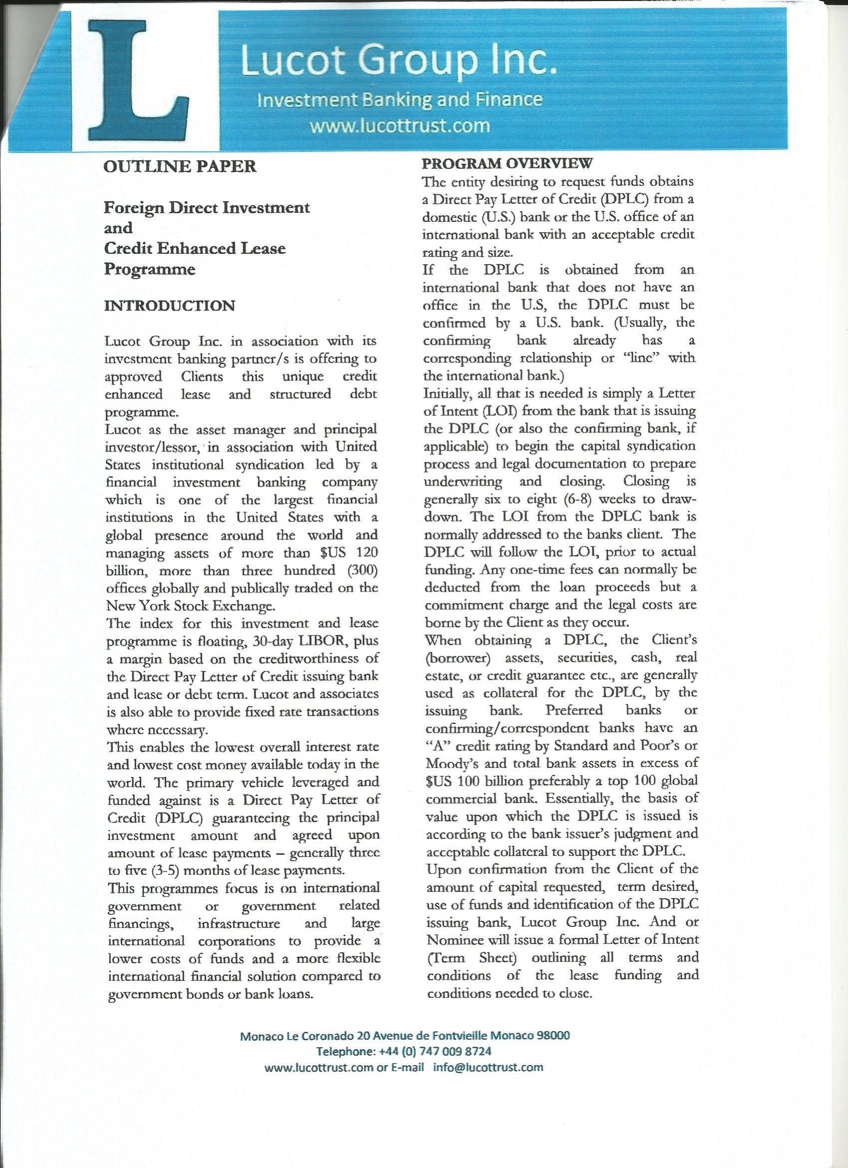
NHI
“Thinking Global, Acting Local”
© February 2016

Slide 62
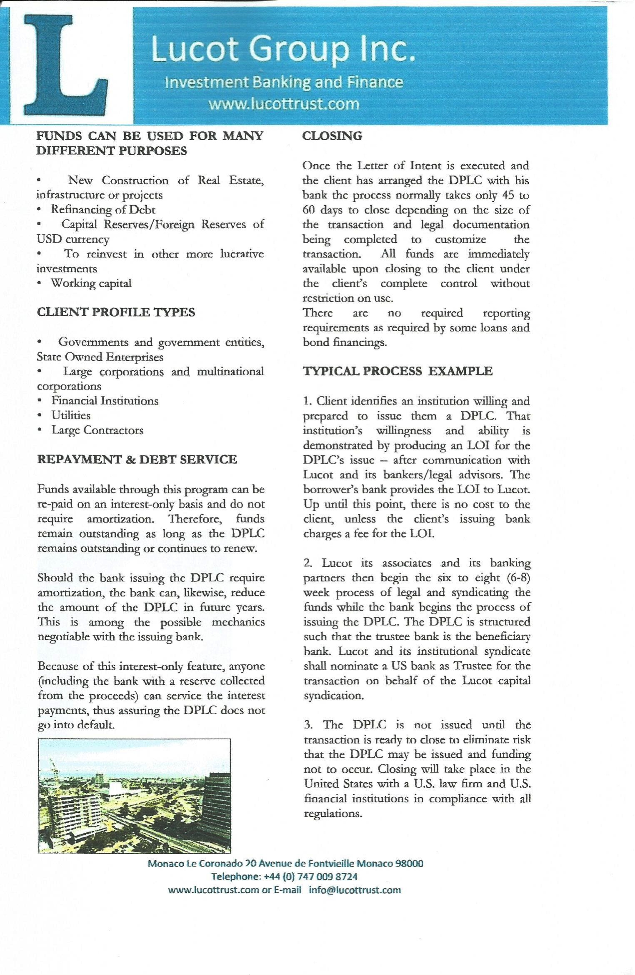
NHI
“Thinking Global, Acting Local”
© February 2016

Slide 63
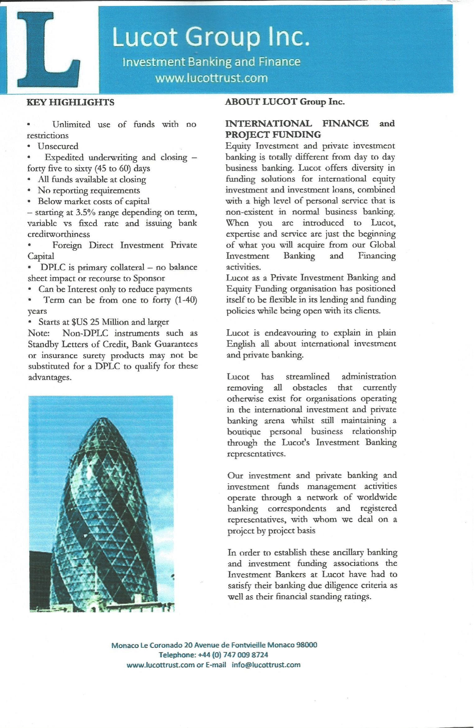
NHI
“Thinking Global, Acting Local”
© February 2016

Slide 64
NHI
“Thinking Global, Acting Local”
© February 2016

Slide 65
NHI
“Thinking Global, Acting Local”
© February 2016

Slide 66
NHI
“Thinking Global, Acting Local”
© February 2016

